Slide 1








Internship
2nd Review-2024
Internship record
Statistics
Name: Niraj Ghetiya.
Enrollment No. :200200107038 Department: Computer Engineering
College : Government Engineering College Rajkot

Slide 2


Contents
01
Project Updates
02
Current Technology
03
Company Project

Slide 3

Project Updates
01

Slide 4






TSS Consultancy Private Limited
Bank Management System
Technologies Used in this Project:-
Mission
Fighting financial crime, maximzing compliance and simplifying operations by delivering world-class technologis at high velocity.

Slide 5
TSS Consultancy Private Limited
Bank Management System
Project Overview :-
Aim :- Developing a comprehensive bank management system.
Scope :- Covers various aspects including customer management, account handling, transaction tracking.
Platform :- Backend APIs
Problem Statement :-
Current bank management systems lack integration and efficiency.
Manual processes lead to errors, delays, and security risks.
Difficulty in tracking transactions and managing customer data effectively.
Mission
Fighting financial crime, maximzing compliance and simplifying operations by delivering world-class technologis at high velocity.

Slide 6
TSS Consultancy Private Limited
Bank Management System
Solution Approach :-
Development of a centralized system for seamless integration of banking operations.
Utilization of modern technologies such as C#, .Net and Ms Sql.
Features :-
Customer management :- Customer Profile creation.
Account Handling :- Account creation, balance inquiries, Current Ac, Saving Ac, translation history.
Transaction tracking :- monitoring of Deposits, Withdrawals, and Transfers.
Mission
Fighting financial crime, maximzing compliance and simplifying operations by delivering world-class technologis at high velocity.

Slide 7
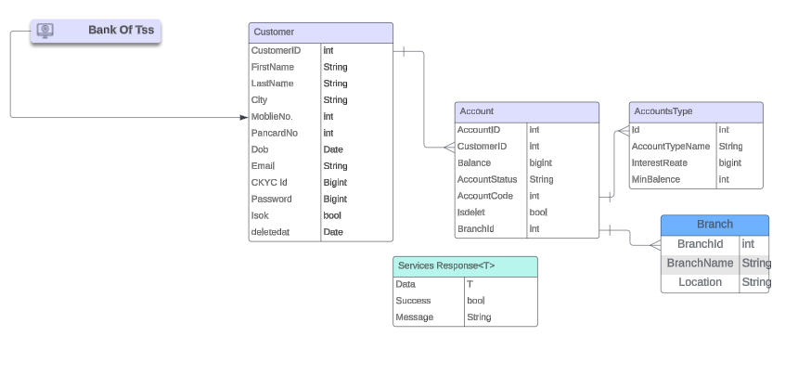
TSS Consultancy Private Limited
Bank Management System
Database Design :-
Mission
Fighting financial crime, maximzing compliance and simplifying operations by delivering world-class technologis at high velocity.

Slide 8
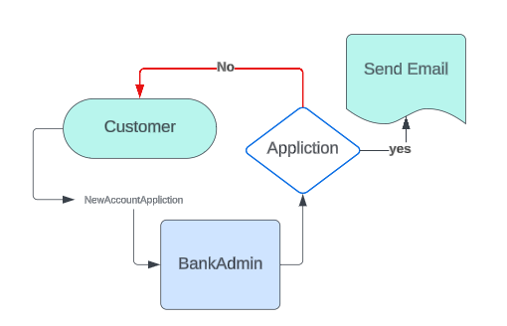
TSS Consultancy Private Limited
Bank Management System
Mission
Fighting financial crime, maximzing compliance and simplifying operations by delivering world-class technologis at high velocity.

Slide 9
Current Technologies
02

Slide 10




TSS Consultancy Private Limited
Current Technologies
Backend:- Java, Spring Boot, Python, FastAPI
Mission
Fighting financial crime, maximzing compliance and simplifying operations by delivering world-class technologis at high velocity.

Slide 11



TSS Consultancy Private Limited
Current Technologies
Database :- PostgreSQL
It is Open-source RDBMS.
Supports complex queries and transactions.
Version Control:- Git and Github
Mission
Fighting financial crime, maximzing compliance and simplifying operations by delivering world-class technologis at high velocity.

Slide 12
Company Project
03

Slide 13


TSS Consultancy Private Limited
Technologies Using in This Project
Backend:- Java, Spring Boot, Python, FastAPI
Database :- PostgreSQL.
Containerization:- Docker, Kubernetes.
Version Control:- Git and Github
Mission
Fighting financial crime, maximzing compliance and simplifying operations by delivering world-class technologis at high velocity.

Slide 14
TSS Consultancy Private Limited
My Role in Company Project
Developing APIs using Spring Boot and FastAPI.
Write Unit Tests and Integration Tests.
Understanding the Codebase.
Work with ML developers for Help them in Data Classification.
Helping Sr. Developers in solving their bugs.
Learning about Docker and some Devops Concepts.
Mission
Fighting financial crime, maximzing compliance and simplifying operations by delivering world-class technologis at high velocity.

Slide 15
Thank you
Thank you!

